Slide 1



WORK REPORT
YOM
HOCHSCHULE FÜR TECHNIK UND WIRTSCHAFT DRESDEN (FH) Fakultät Informatik/Mathematik
ZHEJIANG UNIVERSITY OF SCIENCE AND TECHNOLOGY(ZUST)
Information and Computing Science
Wang Can & Luo Runyi

Slide 2
CONTENTS
01
02
03
Introduction
Work Summary
Future Work

Slide 3
01
Introduction
1. The structure of the project after rebuilding
2. Show how the functions work
3. OneSignal

Slide 4
01
Introduction
—— The structure of the project after rebuilding
1. Reuse pages cause lots of problems
- Have to add complicate additional conditions to deal
WHY
- After fixing a problem, but another will come up soon
- Too much code in one page(difficult to maintain)
2. Bad User Interface
- Before data being loaded completely, the view comes up first
3. Optimized Code
- Delete many redundant code
- Reflect on if it’s a good way to realize

Slide 5
01
Introduction
—— The structure of the project after rebuilding
Login page
chooseType(index.vue)
detail
preview
project(index.vue)
index.vue
_id.vue
index.vue
_id.vue
TypeItem
ProjItem
BasicInfo
ProjCats
TimeDialog
FillDialog
ImgDialog
ProjDoc
SavingDialog
TipDialog

Slide 6
01
Introduction
—— Show how the functions work
ONLINE
Search a project
Create a project
Update a project
Generate Pictures
Update a project
In DB
OFFLINE
Search projects
Create a project
Update a project
Not In DB

Slide 7
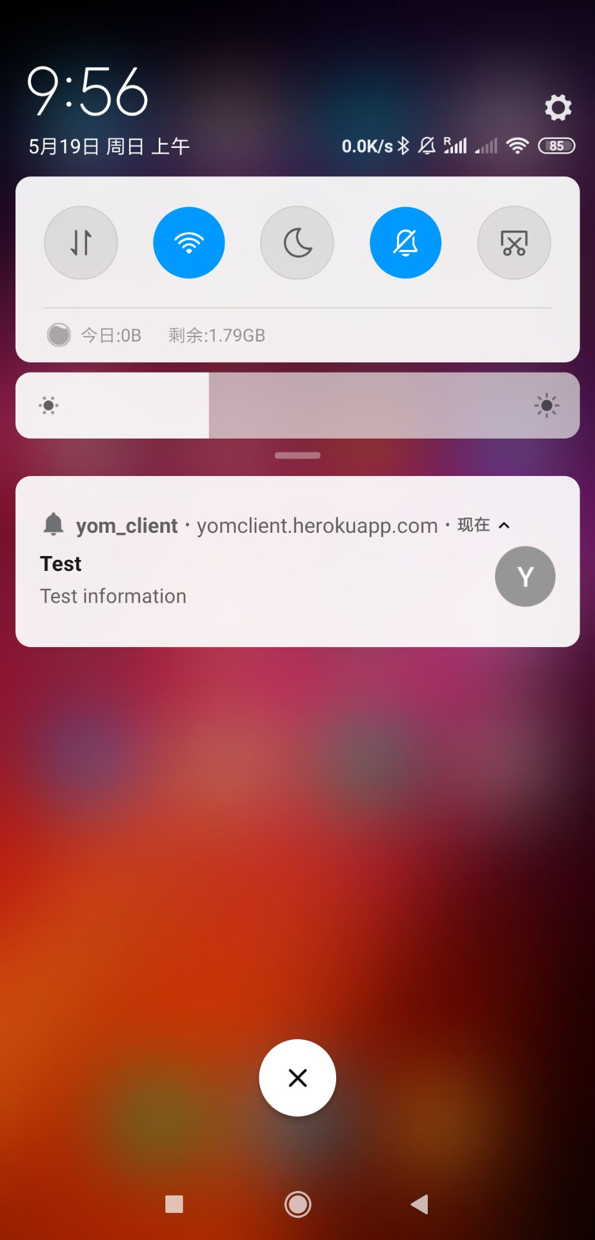
01
Introduction
—— Use Onesignal realize PUSH

Slide 8
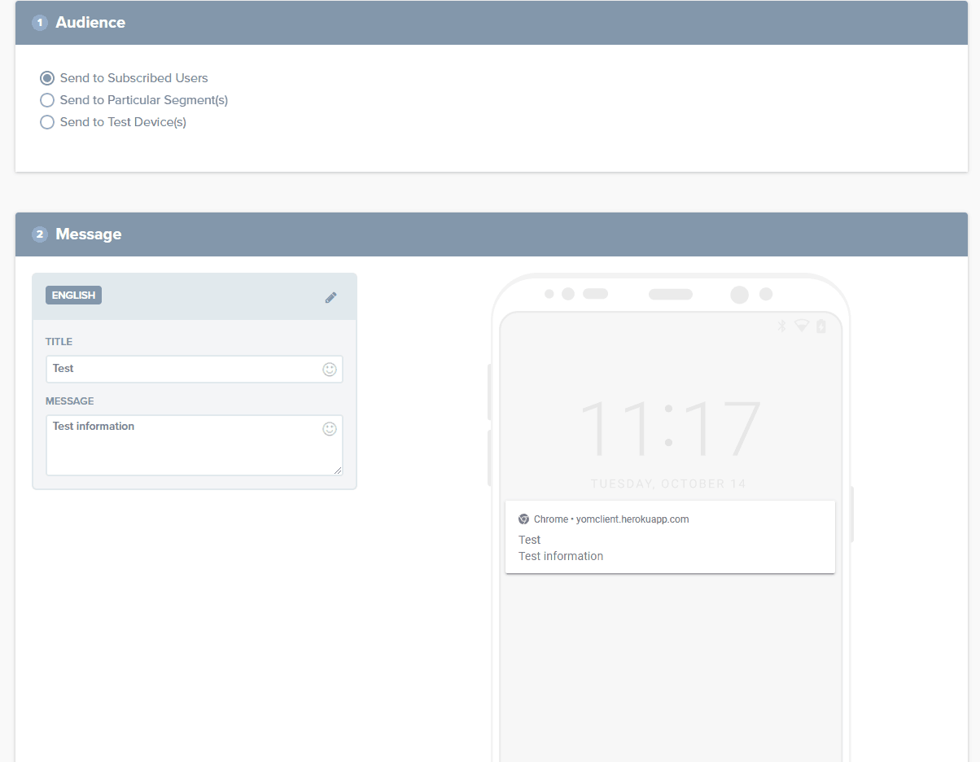
01
Introduction
—— Onesignal edit the information and preview

Slide 9
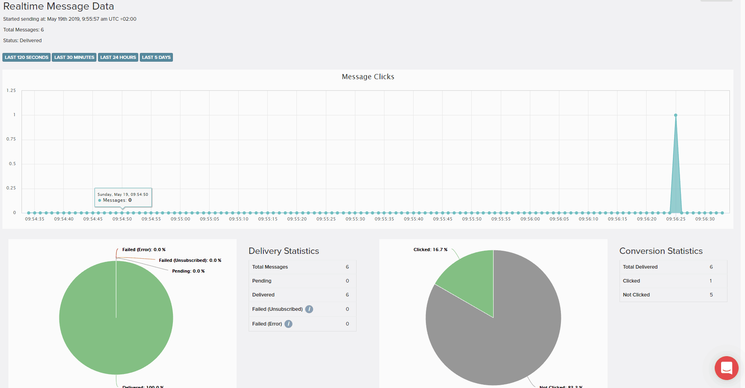
01
Introduction
—— Onesignal backend for analysis

Slide 10
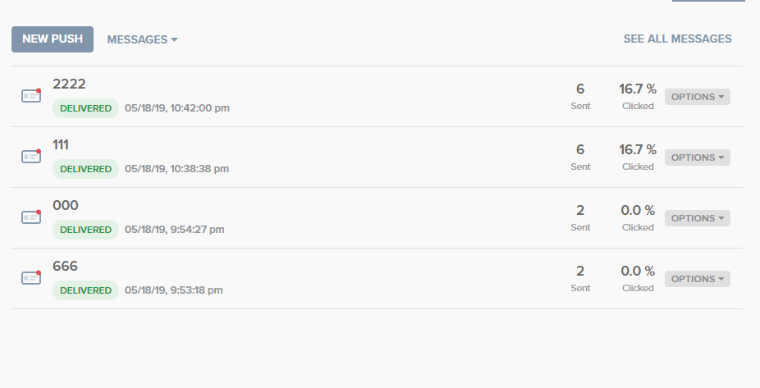
01
Introduction
—— Onesignal all message send before

Slide 11
02
Work Summary
Background sync time delay
Add OfflineTips
SUGGESTION
DETECT
Service work first loaded

Slide 12
03
Future Work
Modify project details
Finish bachelor thesis

Slide 13
Thank you

